Slide 1
Early Colonization
Part 1-Challenges to
Spanish Power

Slide 2
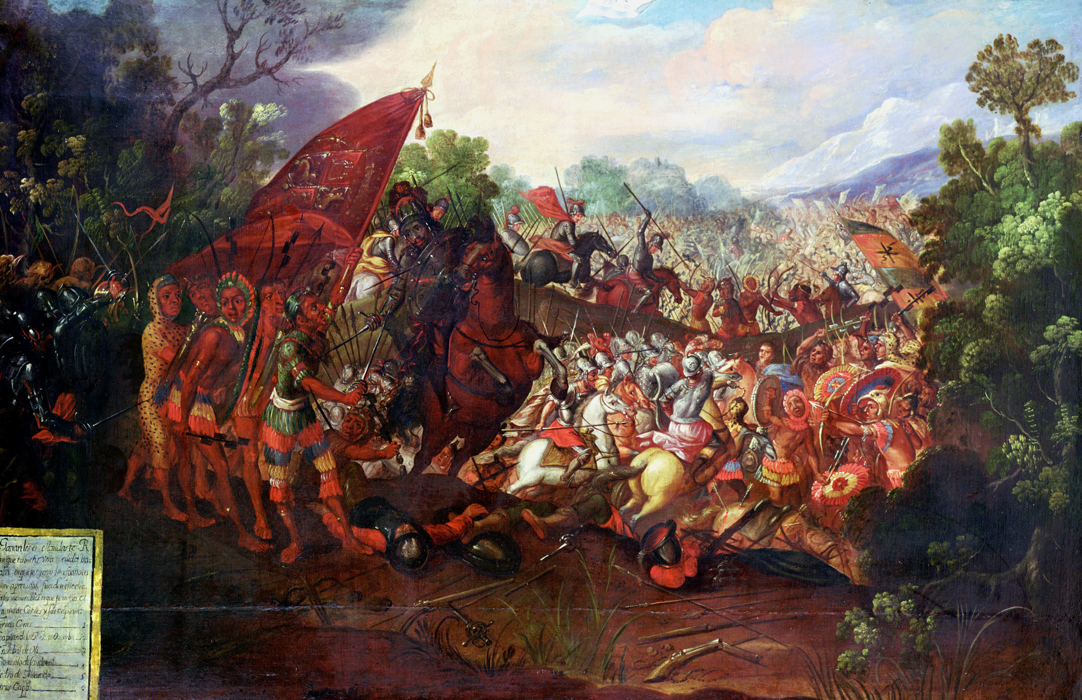
During the 1500s, Spain was the most powerful country in the world.

Slide 3
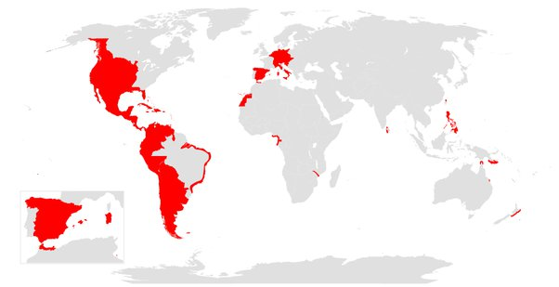
Its empire stretched east to the Philippines and India and west across the Atlantic to Central and South America.

Slide 4
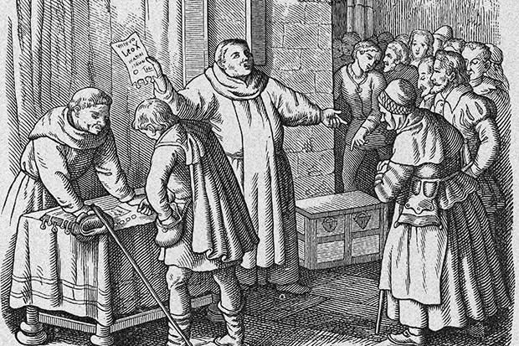
As it was in Spain, most of Europe was Catholic. The Catholic Church was very powerful but had also grown corrupt.

Slide 5
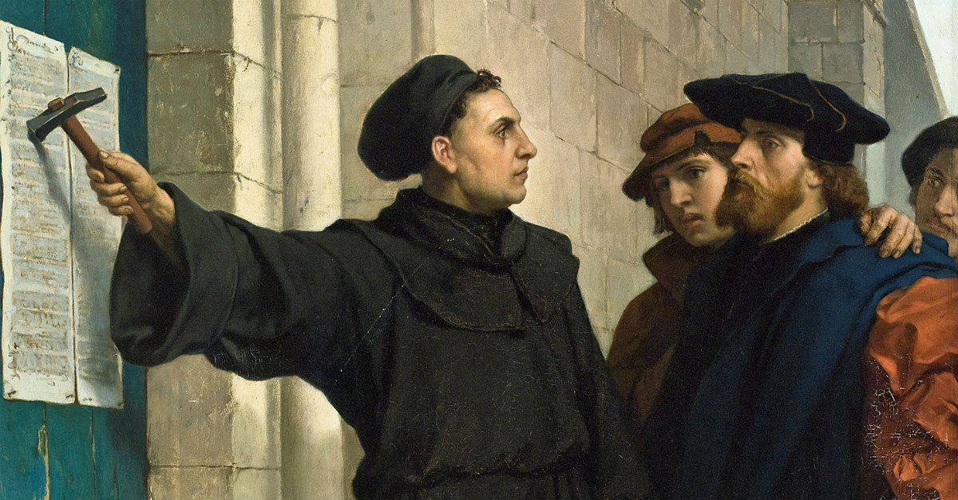
Because of the corruption and the fact that ordinary people could now own a Bible because of the invention of the printing press, many people wanted to see change in the Church.

Slide 6
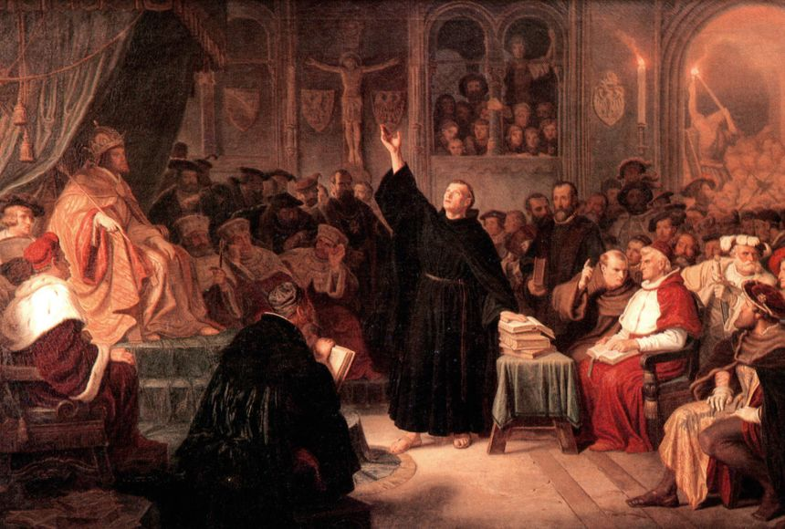
This led to the Protestant Reformation where many people protested against the Catholic Church. These people became known as Protestants.

Slide 7
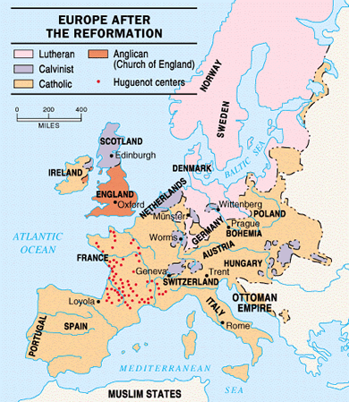
Over the century many northern European countries became Protestant, while many southern European countries, like Spain who saw themselves as defenders of the Catholic Church, remained Catholic.

Slide 8
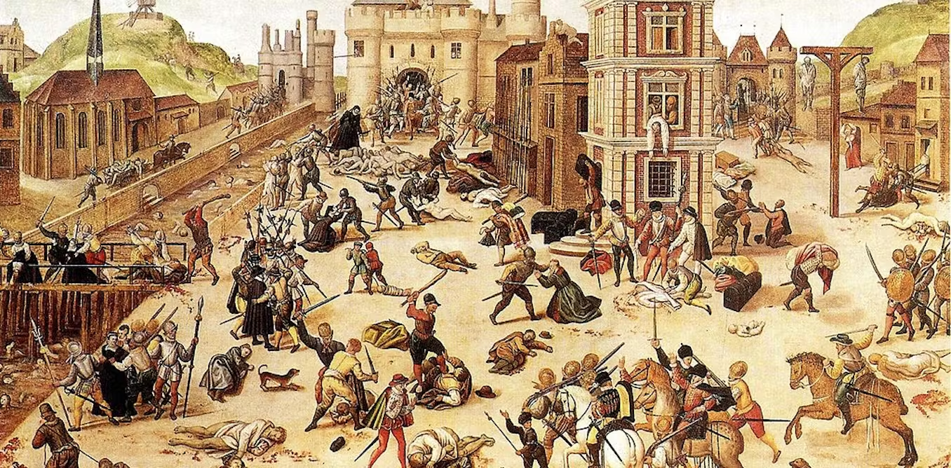
This led to many religious wars between Catholics and Protestants throughout Europe. The violence eventually made its way to America.

Slide 9
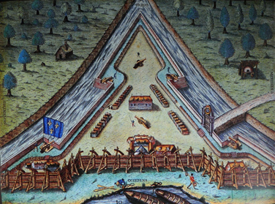
In 1564, a group of French colonists established Fort Caroline near present-day Jacksonville, Florida. Among the group were Huguenots who were French Protestants.

Slide 10
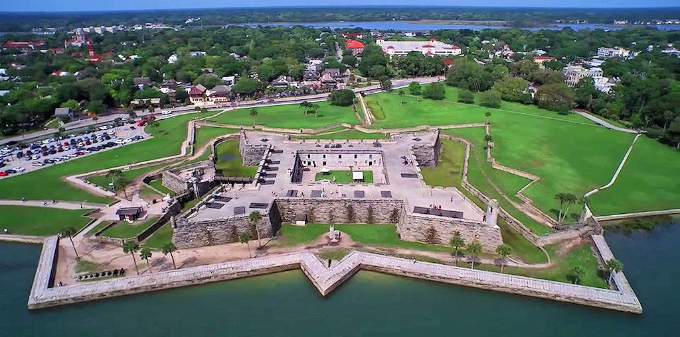
A year later in 1565, the Spanish built a fort at St. Augustine. Today St. Augustine is the oldest permanent European settlement existing in the United States.

Slide 11
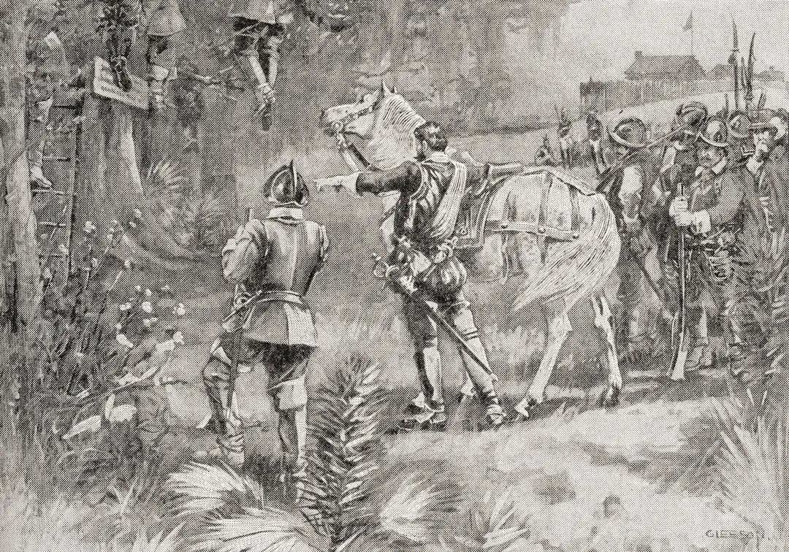
The Spanish would soon destroy Fort Caroline and kill most of the colonists, not because they were French, but because they were Protestant.

Slide 12
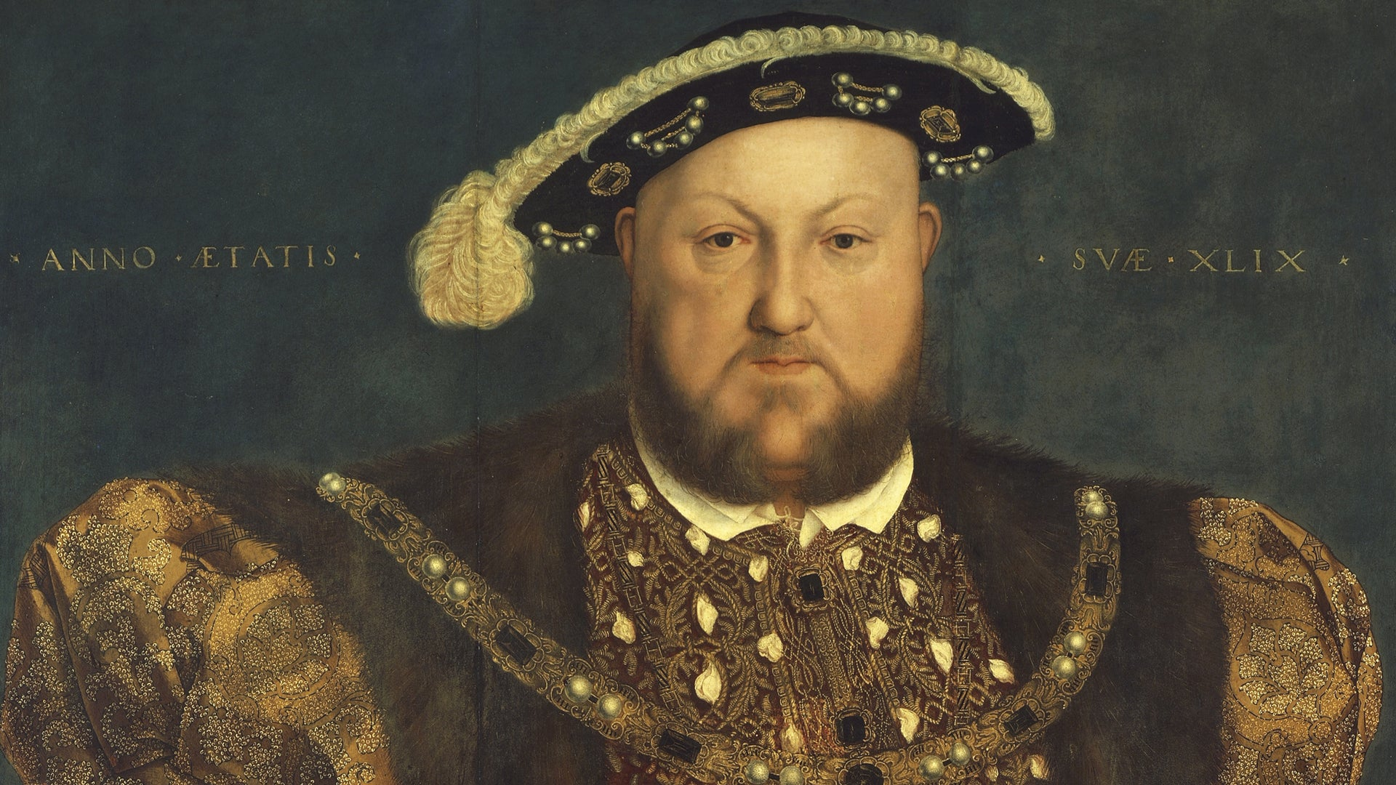
England became Protestant in the 1530s when King Henry VIII started the Church of England after he broke away from the Catholic church.

Slide 13
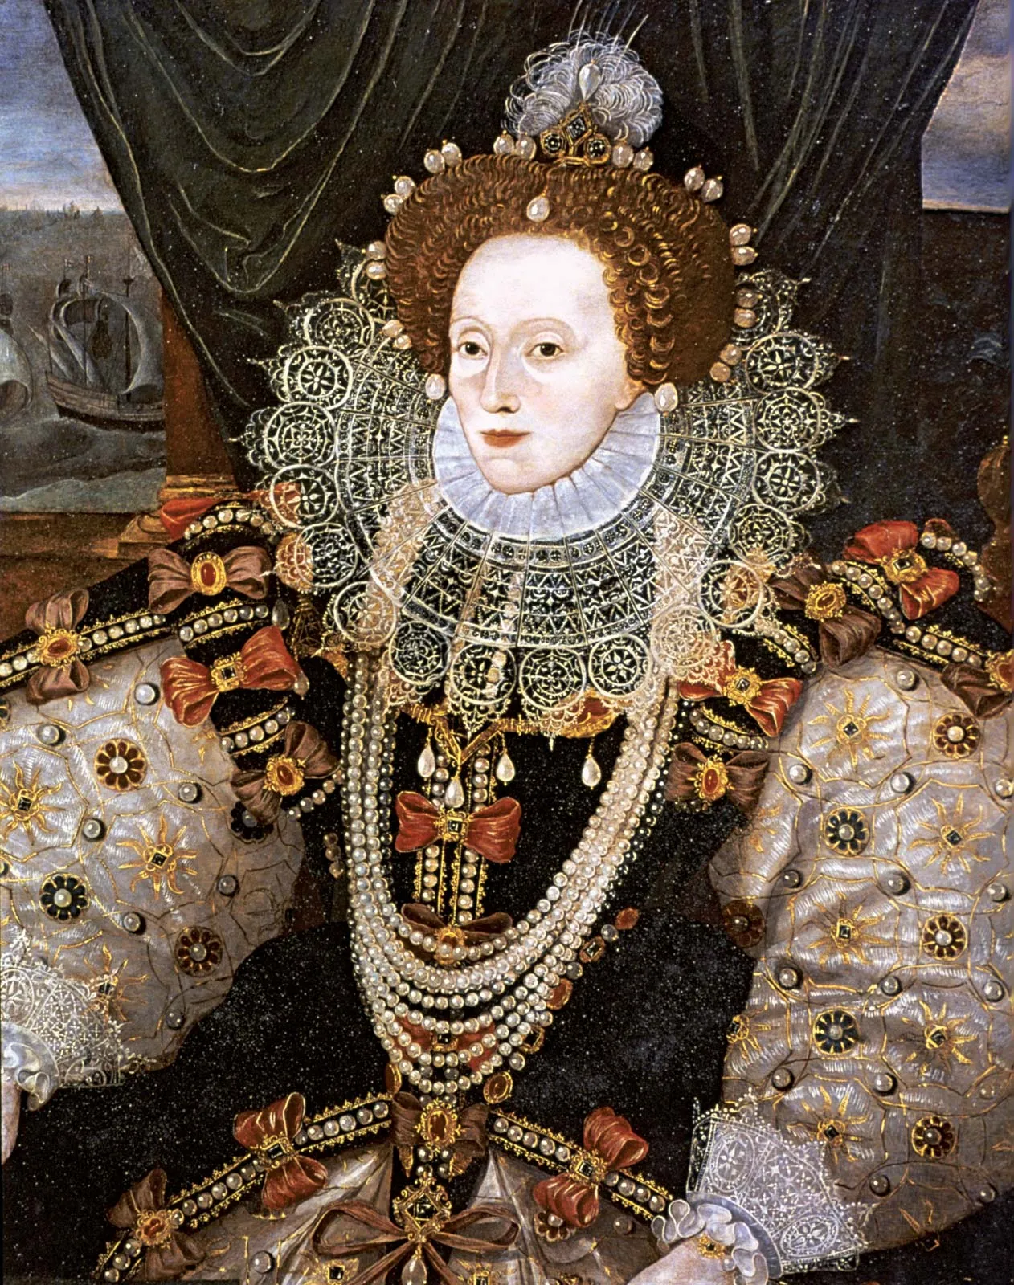
During the reign of Queen Elizabeth I of England which started in 1547, England began to grow more powerful and developed its sea-power.

Slide 14
The English ships that were built were smaller, faster ships than those of other countries, like Spain.

Slide 15
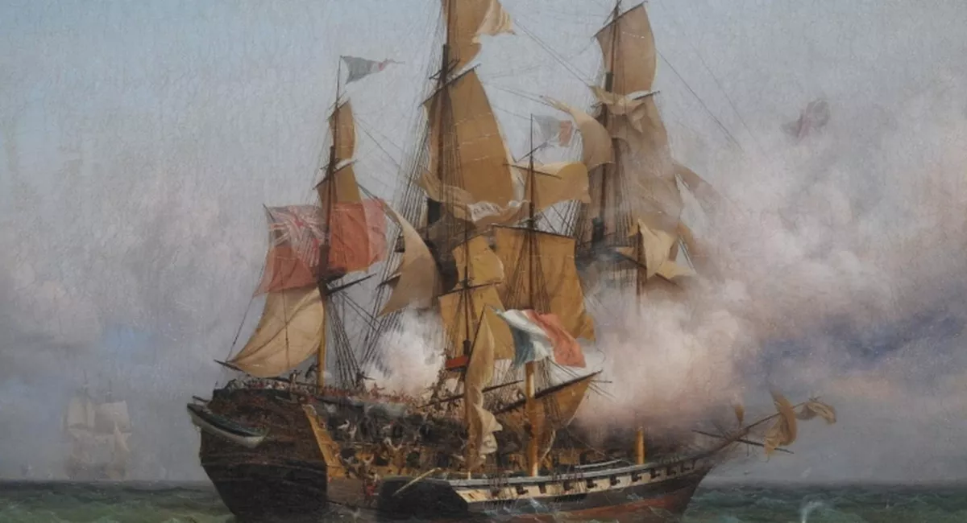
Many English sailors became pirates who could easily capture the larger, slower, Spanish ships carrying treasure from places like America. The name given to the captains of these English pirate ships were sea dogs.

Slide 16
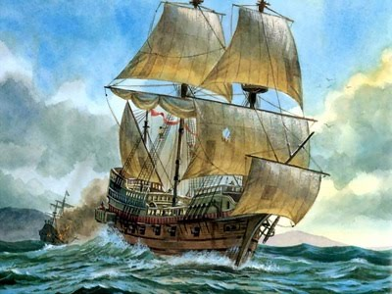
King Philip of Spain decided to teach the English a lesson for these attacks on his ships. He also wanted to turn England back to Catholicism.

Slide 17
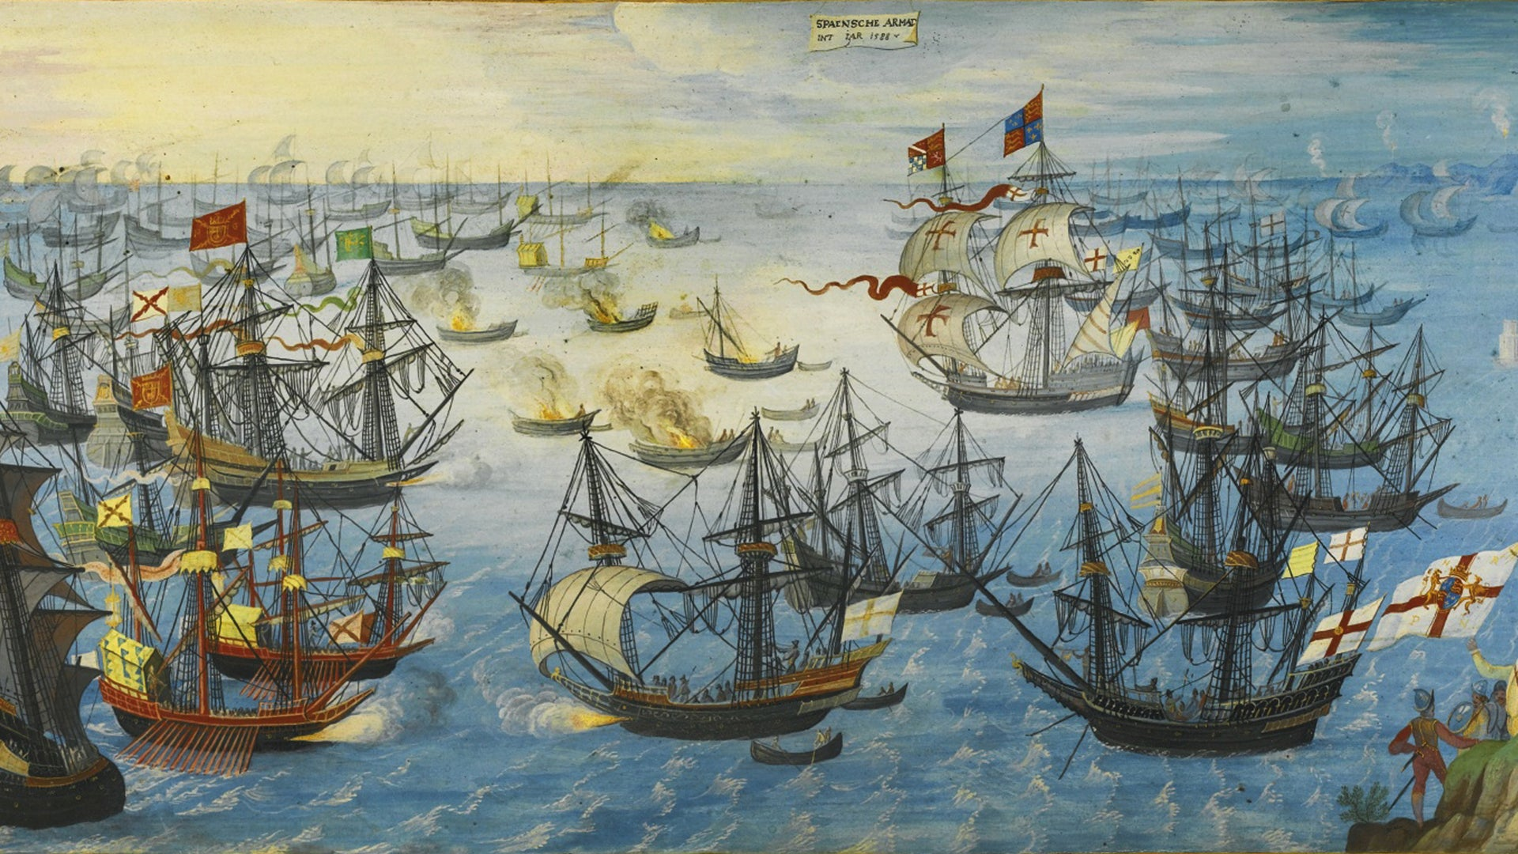
So in 1588, King Philip sent his armada, a giant fleet of warships, to conquer England. Some called the armada of 130 warships the “Invincible Armada”.

Slide 18
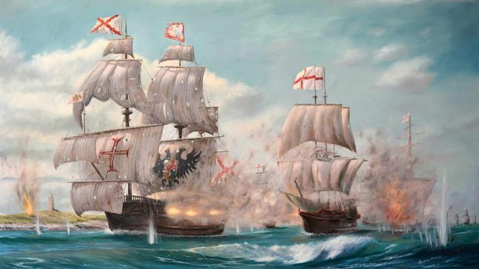
But the outnumbered English ships were able to defeat the Spanish. This proved that the Spain might not be all-powerful, and other nations started looking to North America to set up colonies.

